Slide 1
Working Teaching Cases
Prof. Dr. Dirk Riehle
Friedrich-Alexander University Erlangen-Nürnberg
PROD A03
Licensed under CC BY 4.0 International
Notes:
It is Friedrich-Alexander University Erlangen-Nürnberg – FAU, in short.
Corporate identity wants us to say “Friedrich-Alexander University”.

Slide 2
The (Teaching) Case Method (Recap)
The (Harvard Business School) Case Method is an example-based classroom teaching method used to teach concepts and practices applicable to complex real-world scenarios.
Students prepare for and discuss in class “the case”, a (mostly) realistic representation (10-20 page paper) of a particular situation that a decision maker faced in some context (typically a company).
The case lays out the pros and cons of a difficult decision making situation without suggesting a particular solution; it is up to the students to come up with an opinion and defend it in class.
The case method is suitable for content-to-learn that cannot be easily captured as simple formulas; it aims at complex real-world scenarios, not complicated algorithmic problems.
More information and PM by Case cases available at https://wp.me/Pe4V6-1sW

Slide 3
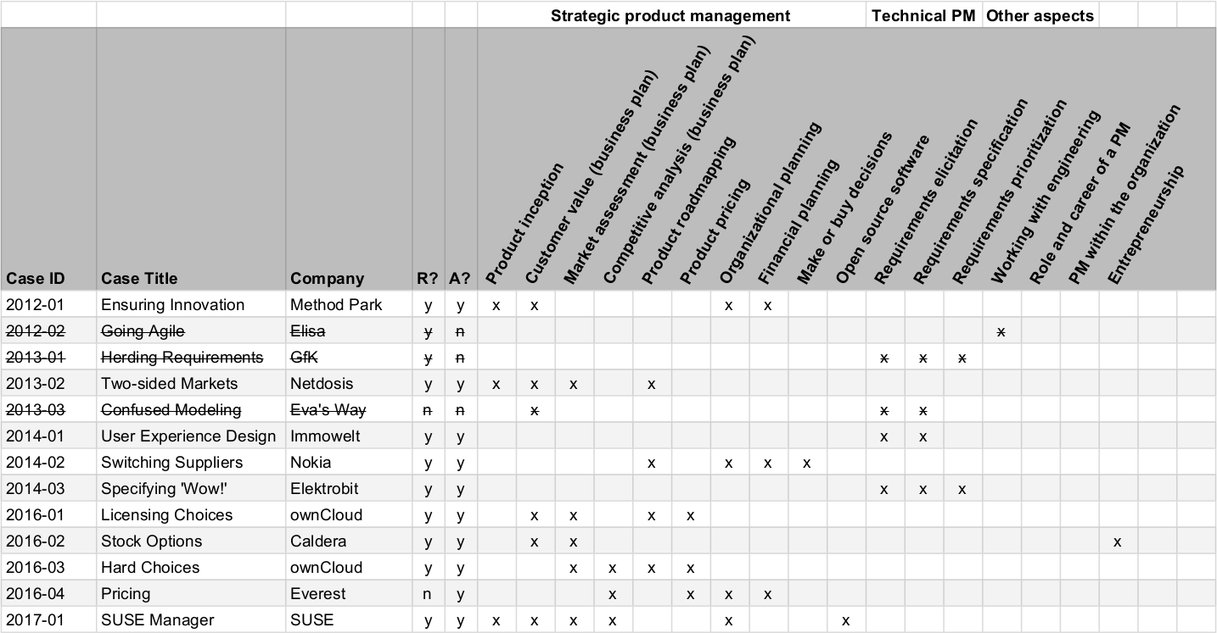

Slide 4
Advice on Working Teaching Cases
http://goo.gl/hk3bzM

Slide 5
Example Analysis Approach
Case question
Linear notes
Analysis framework
Structured notes
Case analysis
Case write-up

Slide 6
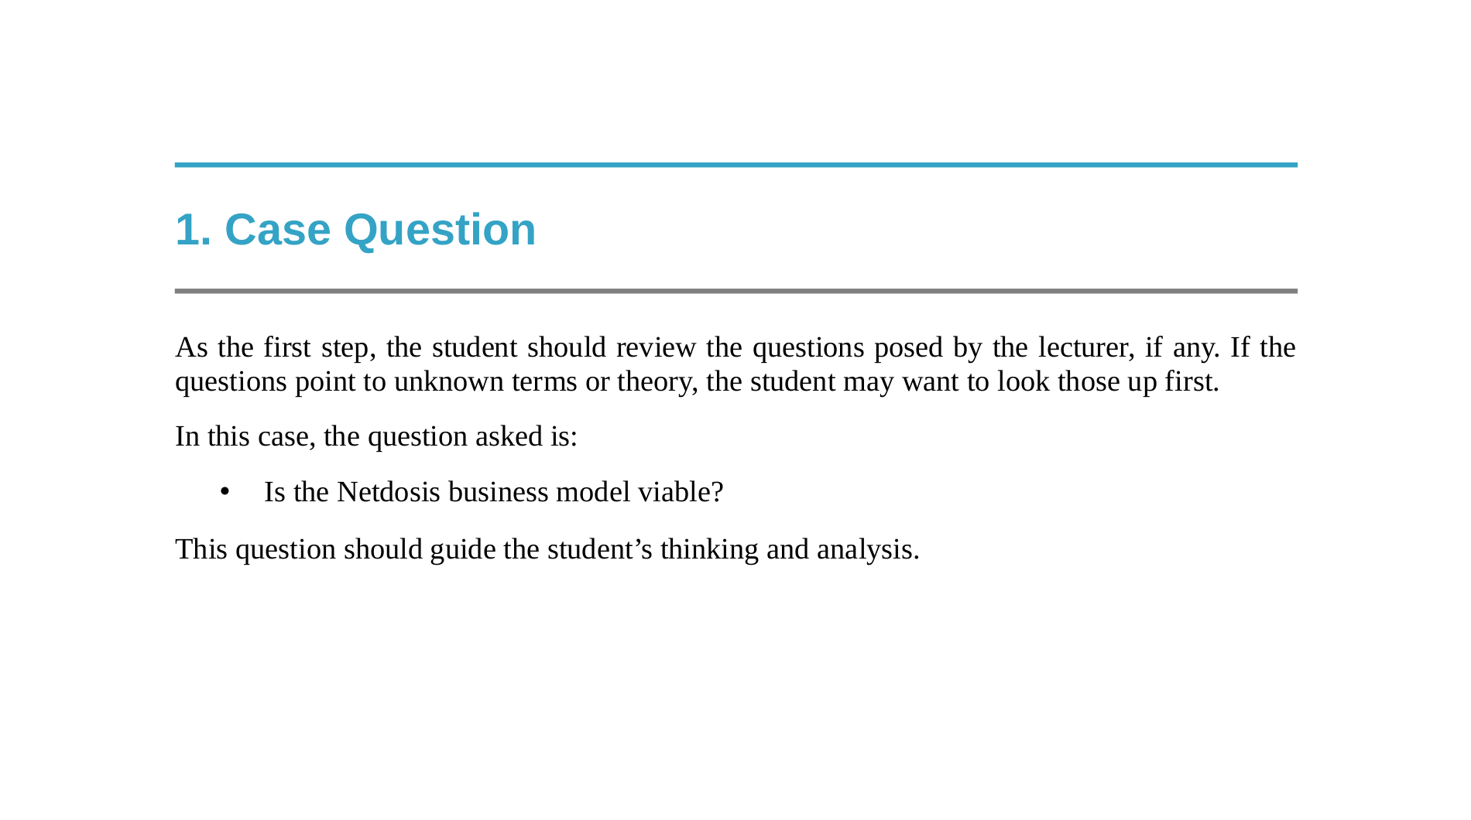

Slide 7
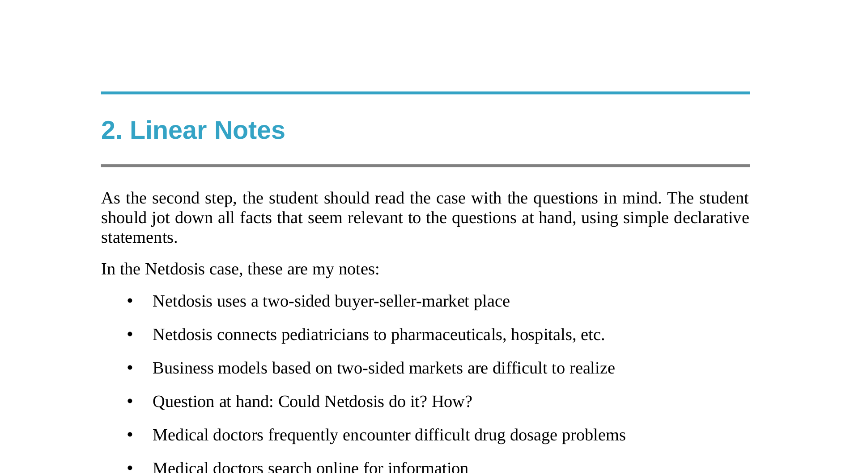

Slide 8
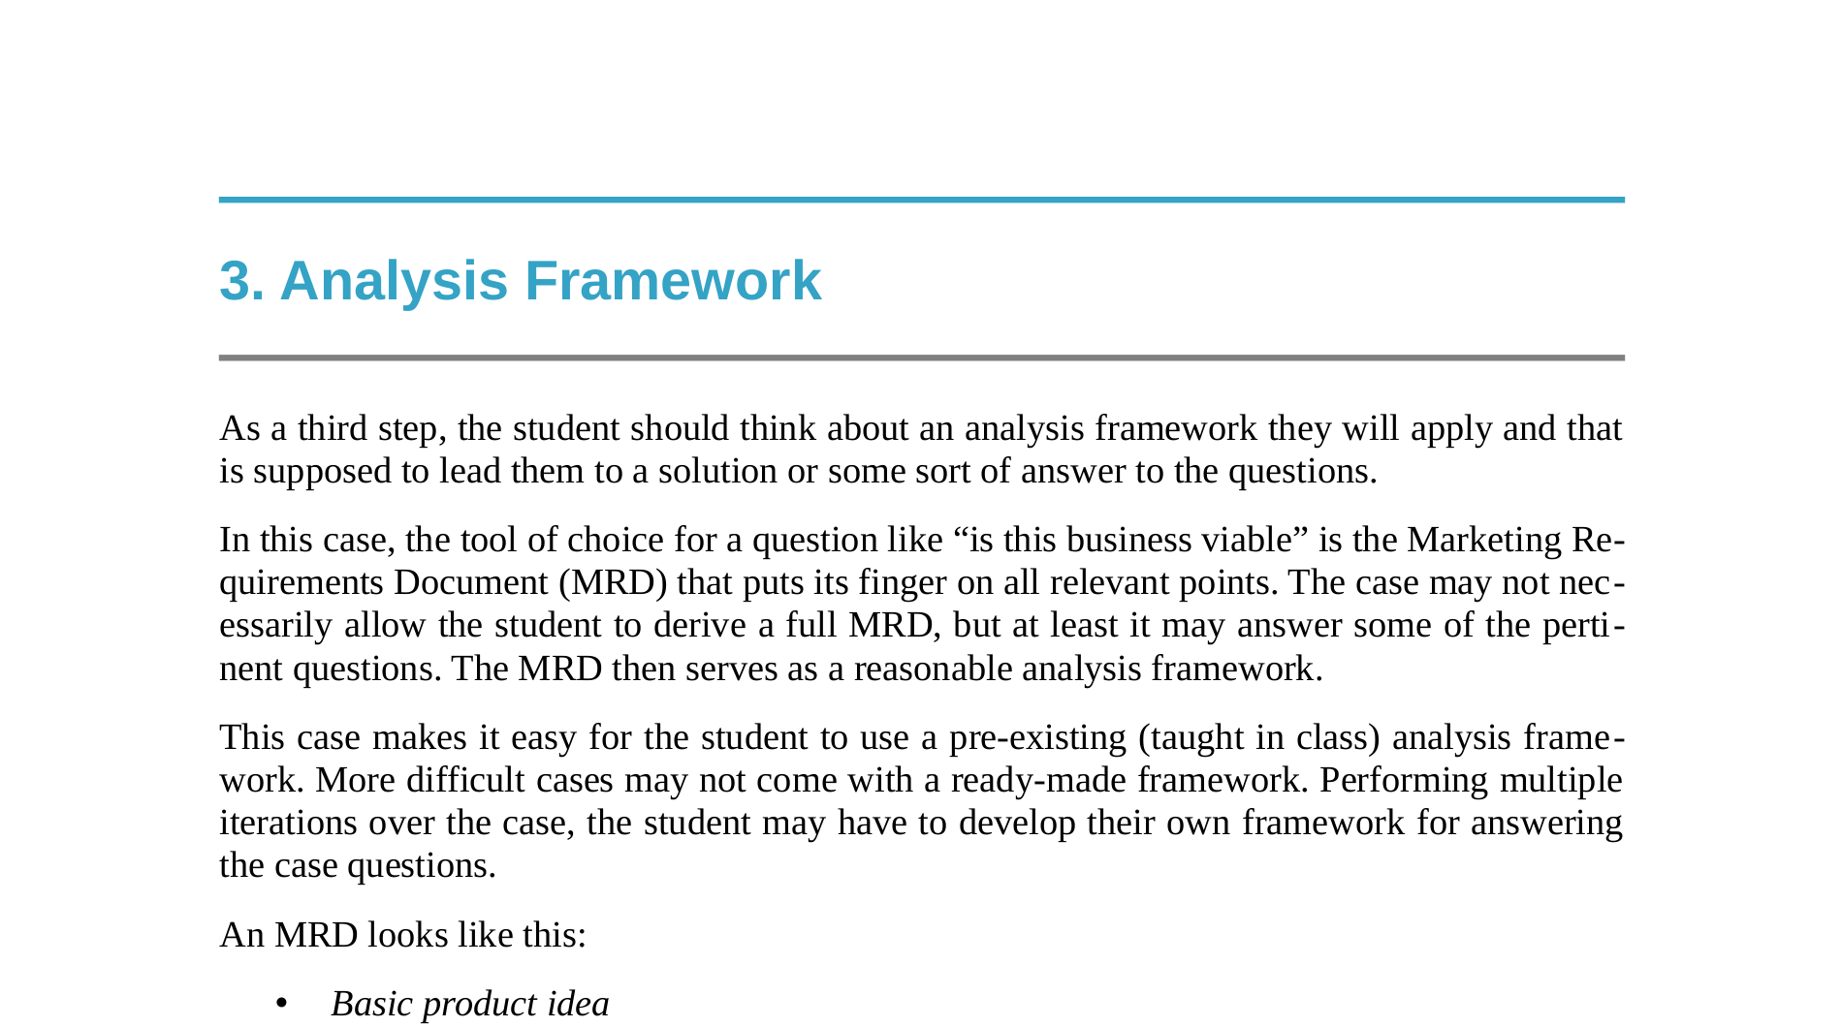

Slide 9
4. Structured Notes
Cf. structured note taking and written summary in Nailing your Thesis (NYT)
  https://goo.gl/0U9PJz
Here, you structure with a purpose, that is, to
  Fill the analysis framework
  Answer the case question

Slide 10
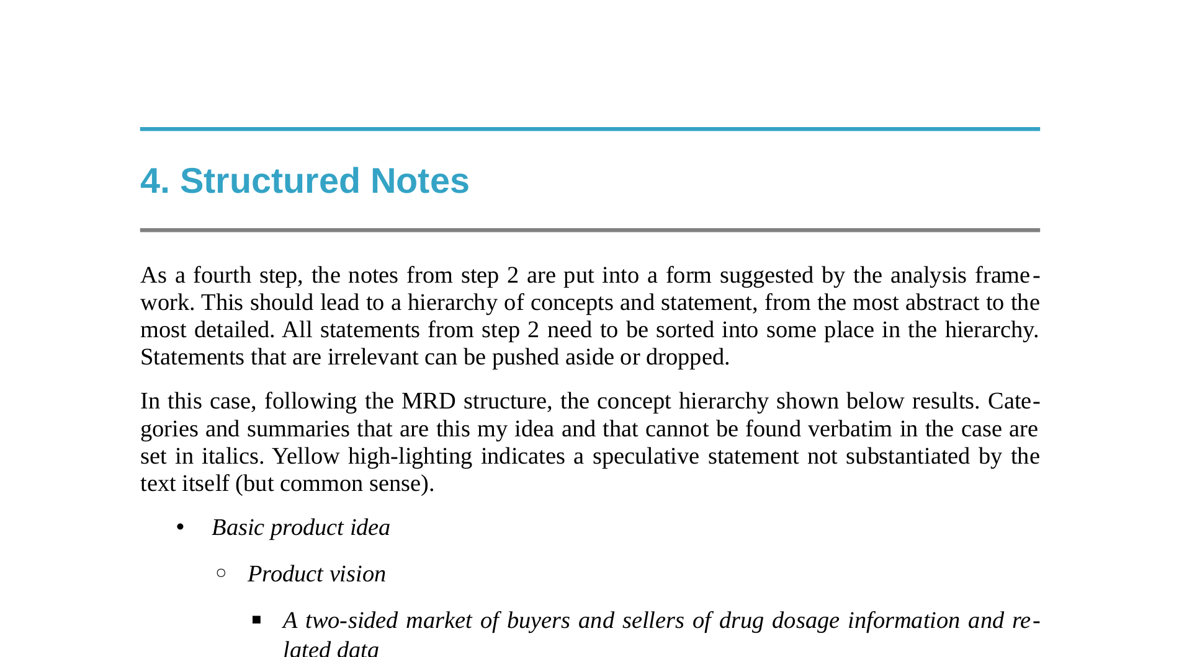

Slide 11
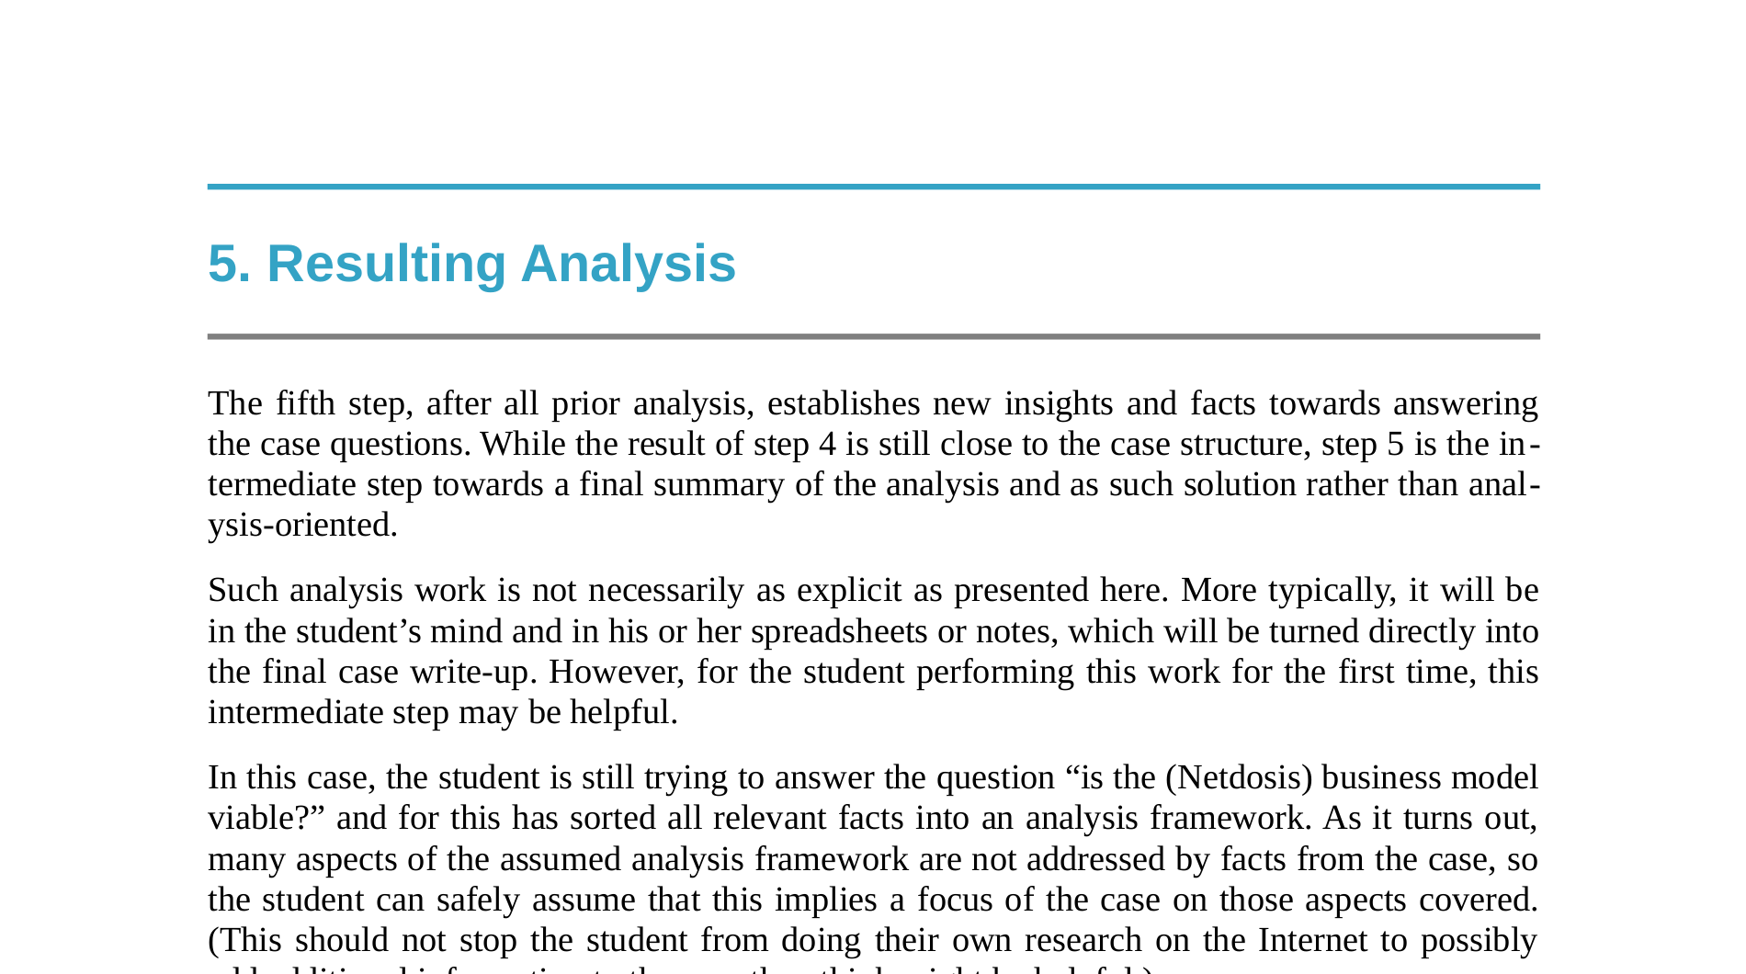

Slide 12
6. Case Write-up
Utilize instructions for Netdosis case at https://goo.gl/6Mti3G

Slide 13
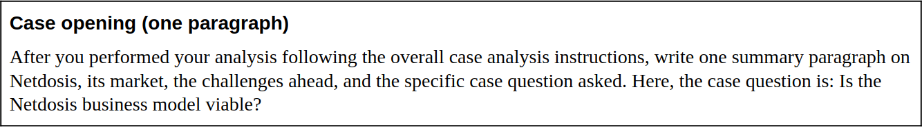
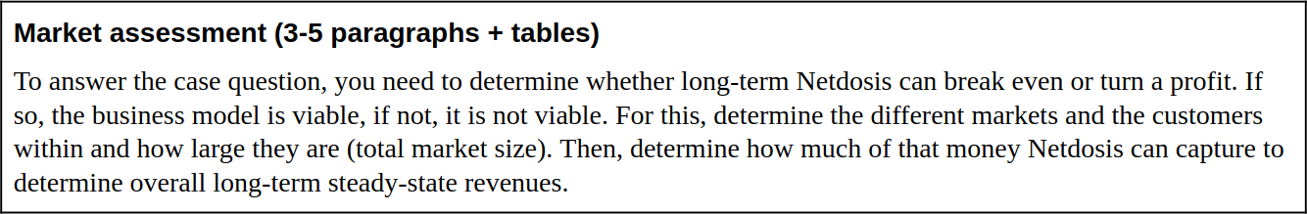
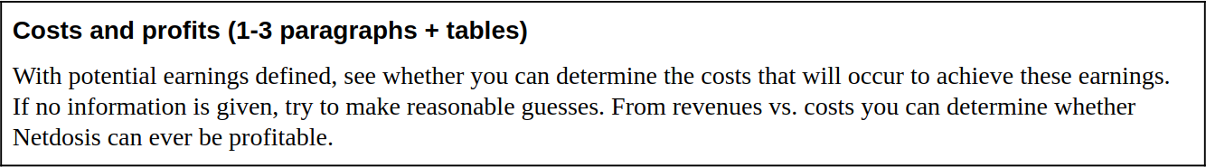
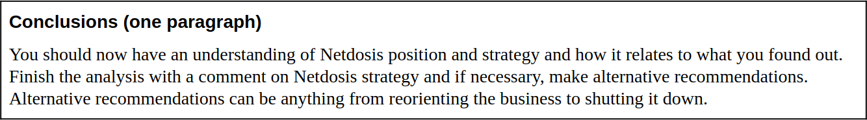

Slide 14
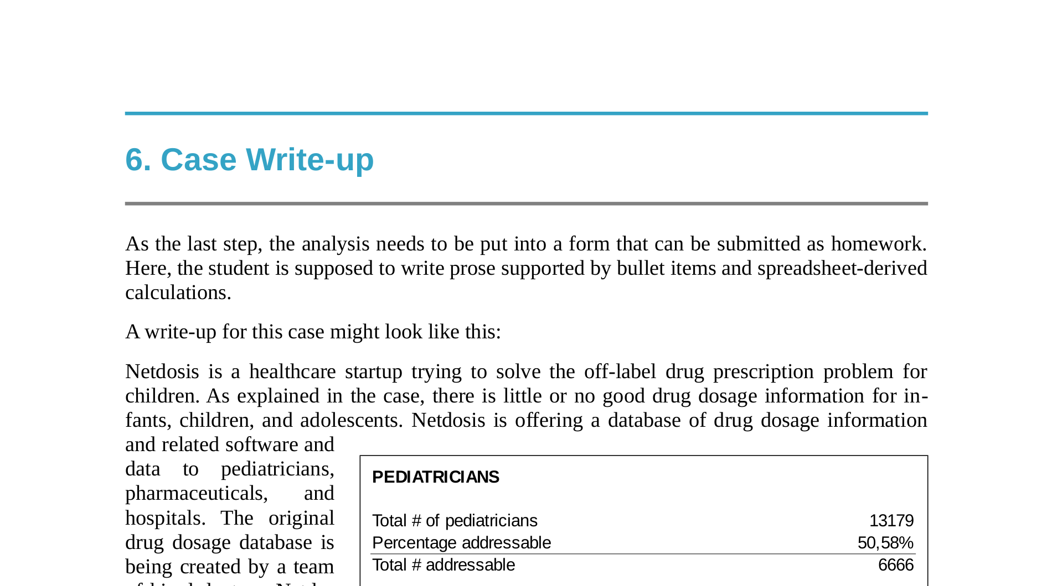

Slide 15
Homework Submission
Keep it to the specific length limit (e.g. 2 pages max.)
Submit on course management site in time
Good luck “cracking the case”!

Slide 16
Thank you! Questions?
dirk.riehle@fau.de – http://osr.cs.fau.de
dirk@riehle.org – http://dirkriehle.com – @dirkriehle
DR

Slide 17
Credits and License
Original version
  © 2012-2018 Dirk Riehle, some rights reserved
  Licensed under the Creative Commons Attribution 4.0 International License
Contributions
  ...

